Slide 1


Lecture 4
Programming Parallel Computers
Lectures: Prof.Janusz Kowalik
Laboratory:
Mgr.Tadeusz Puzniakowski
Informatics Institute
University of Gdansk
October 7-25, 2013

Slide 2
The main reference book
Using MPI
Portable Parallel Programming with
The Message Passing Interface
William Gropp
Ewing Lusk
Anthony Skjellum
Janusz Kowalik editor
The MIT Press, 1994
Scientific and Engineering Computation

Slide 3
Development of Parallel Codes
Software development issue.
Two different paths
Problem to be solved
OpenMP
MPI
Develop
parallel algorithm
Sequential
algorithm
Algorithm
level
Sequential C code
Write parallel code
Using C/ MPI
instructions
Parallelize using
OpenMP
compiler Directives
Code level

Slide 4
Part 4. Message Passing Interface
Introduction to MPI
Message Passing Interface.
MPI Basics
Communication
Point to point Send and Receive
SPMD programs
Message =Data + Envelope
Summary
Key terms

Slide 5
Message Passing System
Each process executes
a copy of the same
program SPMD.
Address space
Process rank= 0
Local
memory
Network
Process
0<rank<p-1
Process rank=p-1
Multiple address spaces.
Each computer has its own
memory and address space .
Address space

Slide 6
Message Passing Model
It assumes that there is:
a collection of processors,
each with its own memory,
connected by a
communication network.
Each processor can access only its own local memory.
Efficiency- local memory access
Inefficiency- message communication

Slide 7
Design of MPI codes
Computer problem solution process
A) Math-formal problem definition
B) Solution algorithm (MPI Design)
C) Code development
D) Debugging
E) Testing
F) Production runs
Industrial vs Academic computing

Slide 8
Advantages of message passing programming.
1. Message passing programs run well on a variety of computer architectures
2. It is possible to implement message passing style of programming on shared memory multiprocessors.
3. Often MPI code does not resemble closely the equivalent sequential program and it can be longer.

Slide 9
continued
4. Debugging message passing programs is simpler than debugging shared memory programs.
,
5. In the message passing style it is easier to construct programs that execute deterministically.
6. But the parallel code is not developed incrementally.
7. Cost of communication ;grouping data for communication is essential.

Slide 10
Message Passing Interface
MPI is the most popular standard library of functions ( for C/C++) or of subroutines ( for Fortran) for
programming multi-computers.
Such a collection of computers is called the Cluster.
It is available on most commercial and academic clusters.

Slide 11
The MPI Programming Model
In the MPI programming model a computation comprises one or more processes that communicate with each other by calling library functions (C) or subroutines(FORTRAN)

Slide 12
continued
In most MPI implementations a fixed number of processes are created at initialization and each process runs on one processor.
In more general cases: processes can be generated dynamically and more than one processes can run on one processor.

Slide 13
continued
. These processes may execute different data but the same code.
This is version of parallel computing called SPMD
(Single Program Multiple Data).
A more general case of parallel program is MIMD (Multiple Instructions Multiple Data)

Slide 14
continued
A single C/MPI program is designed, compiled and run on all processes.
However, all processes are numbered (they are referred by its rank ).
This allows to assign to different processes different functions or different data subsets to the same code.

Slide 15
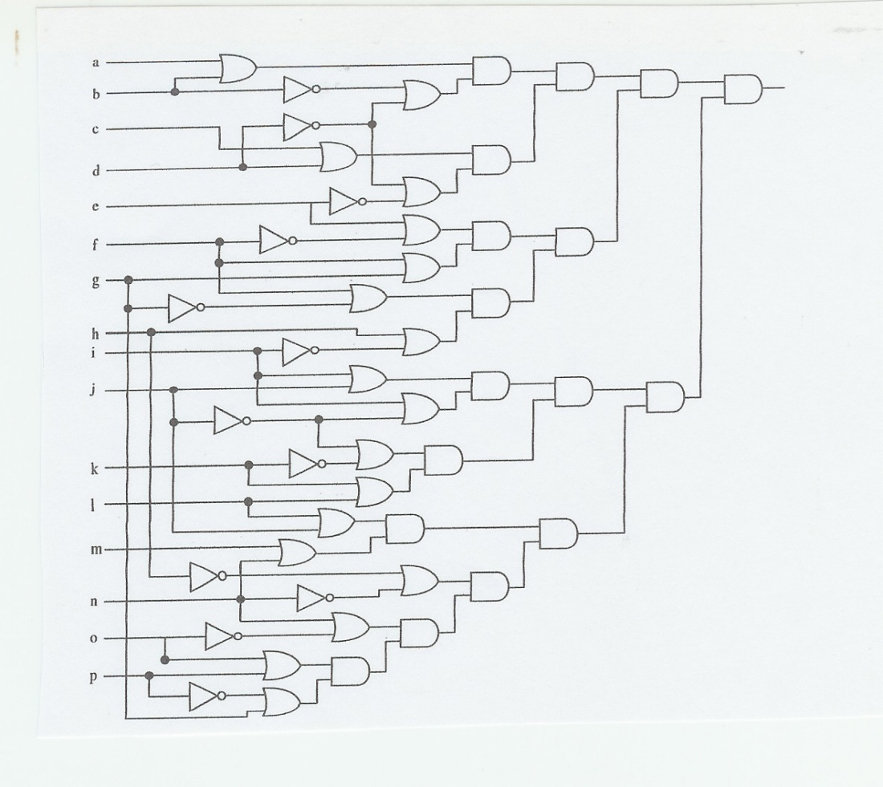

continued
An example; circuit satisfiability
A circuit contains AND,OR
and NOT gates.
Problem:
determine if some combination
of inputs causes the circuit
output to be 1.
This problem belongs to
the NP-complete complexity classs i.e. it does not have an efficient solution algorithm.
We have to try all possible
inputs;

Slide 16
continued
We can try all possible inputs in parallel.
No communication is required.
A trivially parallel problem
This example illustrates a single program
executed with multiple data, SPMD.
In more general cases we can ask processes to execute different portions of a program. This would be the MIMD style of computing.

Slide 17
Information needed to communicate
Which process is sending the message?
Where is the data to be sent?
What kind of data is being sent?
• How much data is there?
Which process is going to receive the message?
Where should the data be left on the receiving process? What amount of data is the receiving process prepared to accept?
.

Slide 18
MPI Basics
The six fundamental MPI functions
MPI_Init initialize an MPI computation
MPI_Finalize terminate a computation
MPI_COMM_SIZE determines number of
PROCESSES
MPI_COMM_RANK determines process
identifiers
MPI_SEND sending a message
MPI_RECV receiving a message

Slide 19
MPI Basics
All but the first two take as an argument the communicator
The communicator identifies a communicating process group.
The default communicator is MPI_COMM_WORLD

Slide 20
MPI Program layout
#include”mpi.h”
main(……….) {
/* no MPI function called before this*/
MPI_Init( & argc, & argv) ;
.
.
MPI_Finalize(();
/* no MPI function call after this line*/
} /*end of main*/
The main body of the code

Slide 21
Send and Receive
The most basic in MPI are the functions for sending and receiving messages.
MPI_Send ( data, count, MPI data type, destination, tag, communicator)
MPI_Recv ( data, count, MPI Data Type, source, tag, communicator )

Slide 22
continued
MPI assumes that processes are allocated statically.
Each process is assigned a unique integer number called the rank 0,1,2,3,……, p-1 where p is the number of processes .
We assume that each process runs on one processor or core.

Slide 23
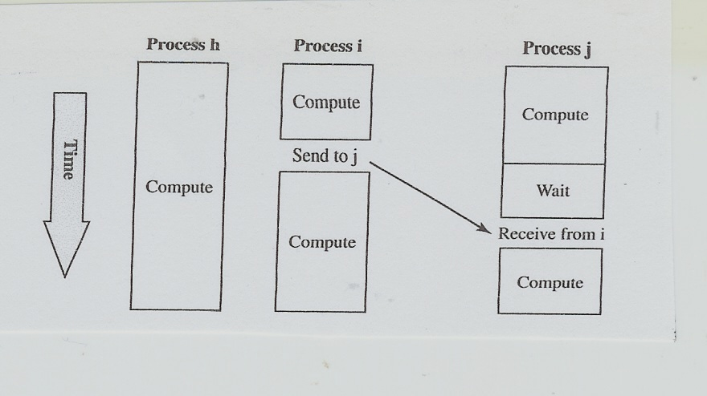
Point to point communication
Point-to-point communications involve pairs of processes
Communication requires time and decreases program speed

Slide 24
Examples
Suppose that process 0 wants to send x to process 1.
MPI_Send (&x,1,MPI_FlOAT, 1,0 , MPI_COMM_WORLD );
MPI_Recv (&x,1, MPI_FLOAT, 0, 0 , MPI_COMM_WORLD );
A single program will include both instructions to process 0 and process 1.

Slide 25
Example
if (my_rank==0)
MPI_Send (&x,1,MPI_FlOAT, 1,0 , MPI_COMM_WORLD );
else if (my_rank==1)
MPI_Recv (&x,1, MPI_FLOAT, 0, 0 , MPI_COMM_WORLD );
my_rank has to be defined before it can be used.

Slide 26
Establishing size and rank
MPI_Comm_size(MPI_COMM_WORLD,&p)
MPI_Comm_rank(MPI_COMM_WORLD,my_rank)
Now we can use both values size and rank.
For example:
If (my_rank ==1) { do something.}
G=2*my_rank-1;

Slide 27
Sending more than 1 data items.
The argument count allows to send multiple of data items.
Suppose we have a vector A with 100
elements and want to send the first half of it from process 0 to process 1.
MPI_Send ( &A[0] , 50, MPI_FLOAT, 1,0, MPI_COMM_WORLD);
A[0],……..,A[49]

Slide 28
continued
This communication is possible for two reasons:
(1) The elements of the vector A are stored in the memory contiguously and
(2) are of the same MPI type.
This way we can also send the entire or a part of two dimensional arrays
Two dimensional arrays are stored in C
contiguously by rows.

Slide 29
An exercise
Process 0 has created a square matrix 4x4 called A.
All elements of A are integers.
Exercise.
We want to send the first two upper rows of A from process 0 to process 1.
Write the MPI instructions accomplishing this task.

Slide 30
Buffering
Questions:
What happens if process 1 delays sending the Recv message ?
Does process 0 wait until its message is received?
Two options:
(i) synchronous communication
Process 0 can send a “request for sending” to process 1 and waits until it gets a permission to send.

Slide 31
continued
(ii) buffered communication
The contents of the message can be copied to a system controlled buffer and process 0 can continue executing.
More efficient option.

Slide 32
Blocking and Non-blocking communication.
When process 1 calls MPI_Recv and the message is not available then process 1 remains idle until the message becomes available. This is called blocking.
Most systems provide an alternative
non-blocking Receive operation

Slide 33
Message = Data + Envelope
Envelope information:
The rank of the sender (source)
or receiver (destination)
Pointer to the beginning of data
Count (Message size)
Datatype
Tag
Communicator

Slide 34
continued
Examples.
MPI_Send ( &y,1,MPI_INT, 1,0, MPI_COMM_WORLD)
MPI_Recv ( &x,1, MPI_INT,0,0 ,MPI_COMM_WORLD, status)
Status returns information on the data that was received.
status -> source
status -> tag
status->error

Slide 35
Summary
Every process runs the same program.
MPI is not a programming language
It is a collection of functions (a library) that can be used in C or Fortran programs.
Every MPI program must contain preprocessor directive #include ”mpi.h”
Every program must call MPI_Init (……)
before it can call other functions.
Every MPI program is finished with
MPI_Finalize()

Slide 36
Saxpy operation
+
Each process
gets N=n/p
Elements of Z to
Compute
n the vector size
p the numbet of
Processes.
=
a
Z
ax + y

Slide 37
An MPI Example
For the purpose of illustrating MPI we will consider a parallel computation of the Saxpy operation. Saxpy is a linear algebra operation z=ax+y where a is a constant scalar and x, y, z are vectors of the same size.
The following assumptions and notations are made:
The number of processes is p.
The vectors size n is divisible by p.
The number of element pairs that must be computed by each process is: N=n/p.

Slide 38
continued
We will write a part of the code for parallel calculation of the vector z.
All required MPI initialization instructions have been done for us in the front part of the code.
The vectors x and y have been initialized.
The process Id is called my_rank that varies from 0 to p-1.

Slide 39
continued
The communicator is the entire system.
Assume:
n=10,000 and p= 10, so N=n/p=1,000
The C loop below will be executed by all processes from the process with
my_rank=0 to my_rank =p-1.
{ int i;
for (i=my_rank*N;i<( my_rank+1)*N; i++)
z[i]=a*x[i]+y[i]; }

Slide 40
continued
For example, the process with my_rank=1 will add one thousand elements a*x[i] and y[i] from i=N=1,000 to 2N-1=1,999.
The process with the my_rank=
p-1=9 will add elements from
i=n-N=9,000 to n-1=9,999.

Slide 41
continued
If we want one process to do something different than others we can accomplish this as follows:
if (my_rank==0)
{
Do something
}
This block will be executed only by the process with my_rank zero.

Slide 42
Data parallelism and task parallelism
Data parallelism:
all processes execute the same program but on different data( Saxpy operation)
SPMD
Task parallelism:
Different tasks ,different data
Load balancing issue
Inefficiency caused by idle time

Slide 43
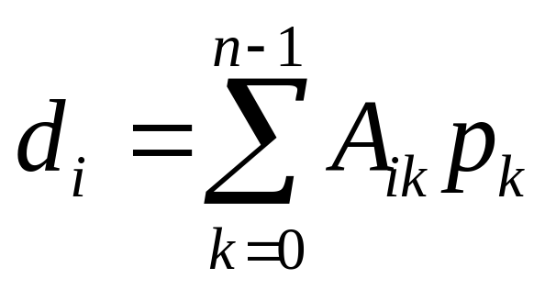
Matrix vector product
To be parallelized in the exercise problem
d=Ap
x
=
Data parallelism: each process executes
the same program but on different data

Slide 44
Task parallelism
C=A*B +(D+E)
C=T1+T2,
T1
T2
Dependency graph;
Directed graph
without loops
A node (Task)
can be executed if
All tasks pointing to it
Hasve been executed
C

Slide 45
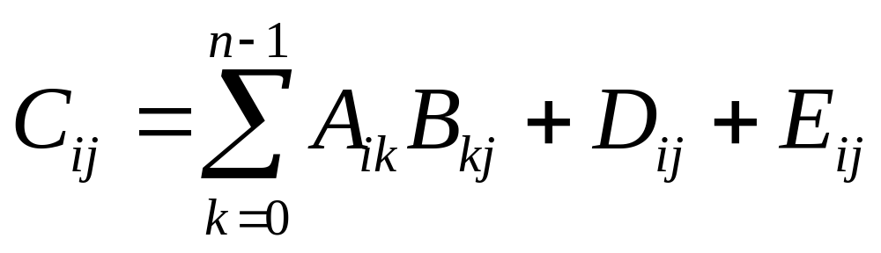
Data parallel computation
C=A*B+D+E

Slide 46
Task or data parallelism?
Medium grain parallelism
C=A*B +(D+E)
C=T1+T2,
Small grain parallelism

Slide 47
Key Terms
Process rank SPMD
Communicator
Data count
Point to point communication
Collective communication
MPI_Send
MPI_Recv
MPI_Init
MPI_Finalize
Tag

